Slide 1
Deep Blue Sea
Science Olympiad
2017

Slide 2
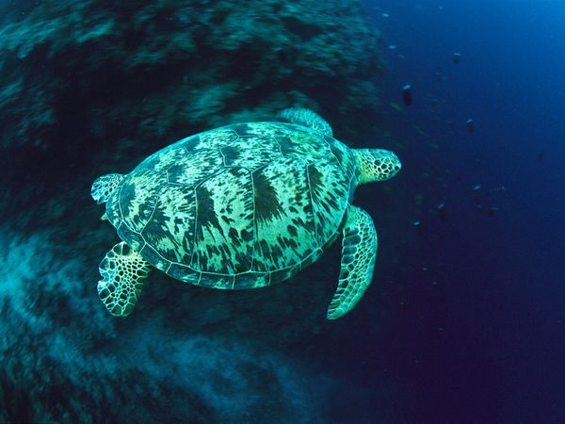
1. What type of sea turtle am I?

Slide 3
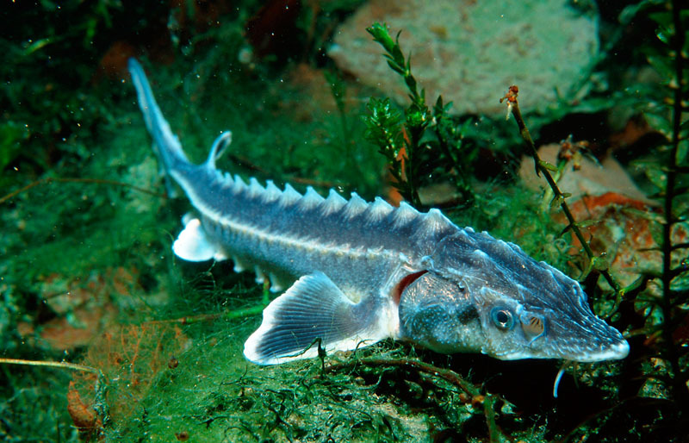
2. What creature am I?

Slide 4
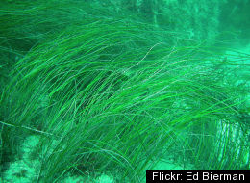
3. What do you call this?

Slide 5
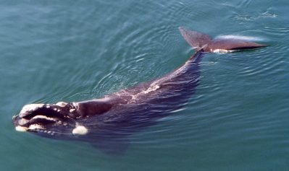
4. I am a ………

Slide 6
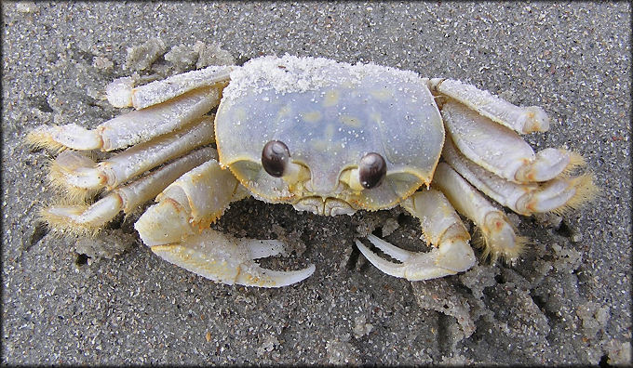
5. What am I?

Slide 7
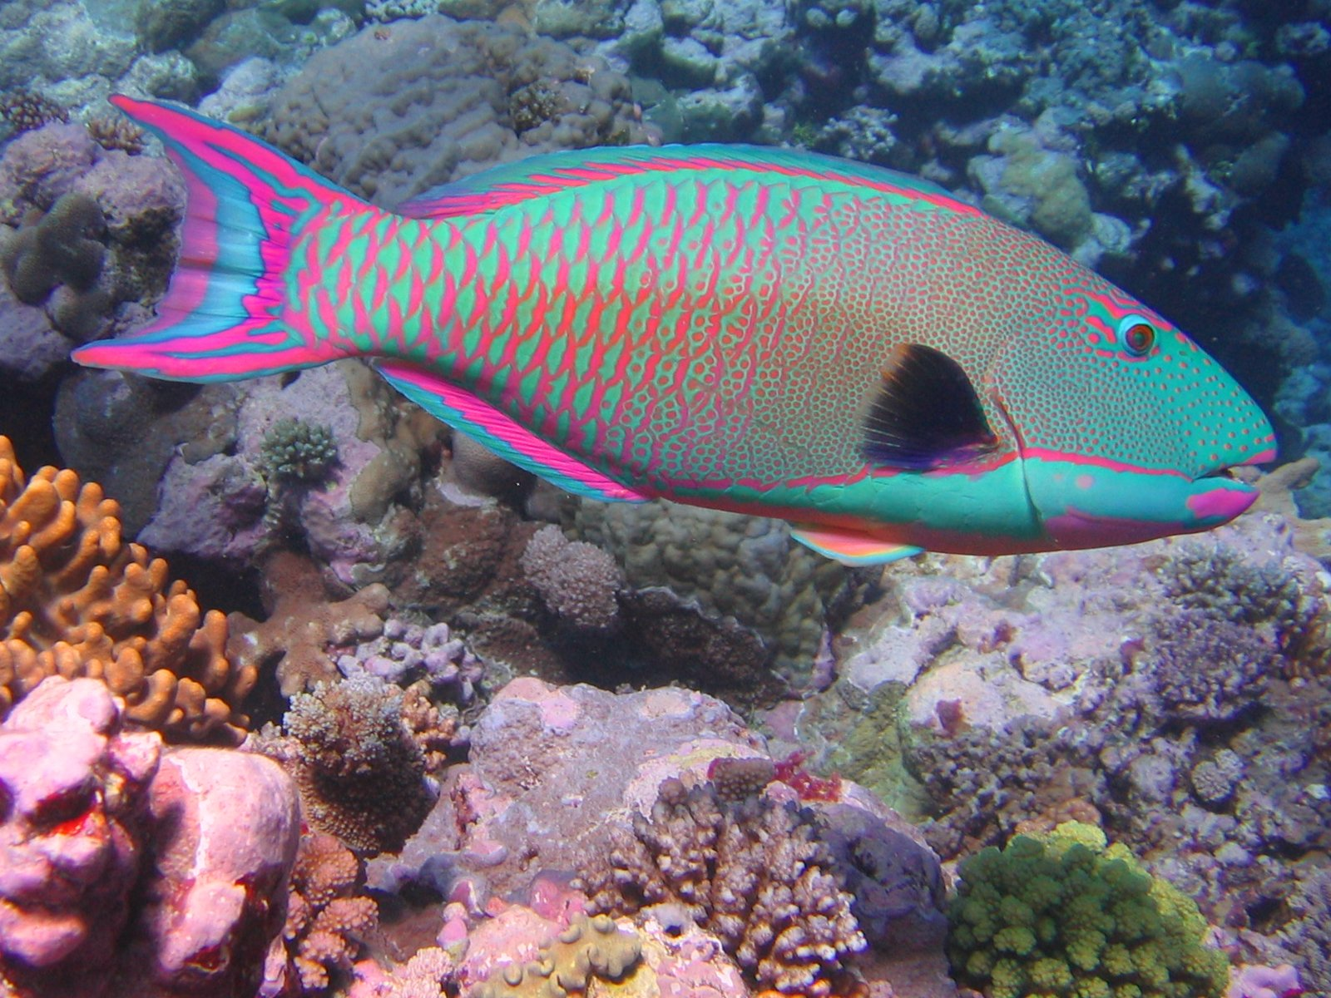
I am a …..

Slide 8
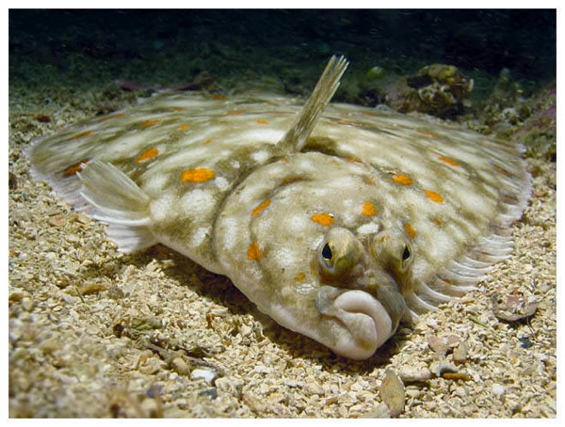
6. What type of fish am I?

Slide 9
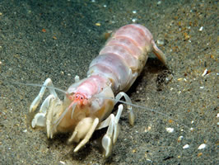
7. I am a….

Slide 10
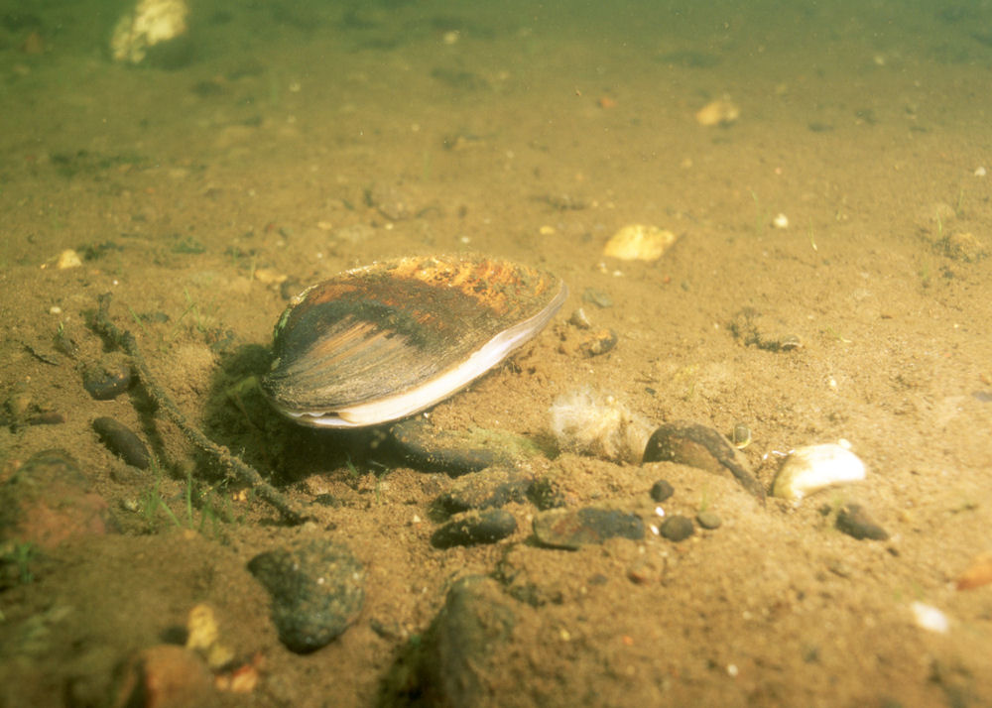
8. I am a …

Slide 11
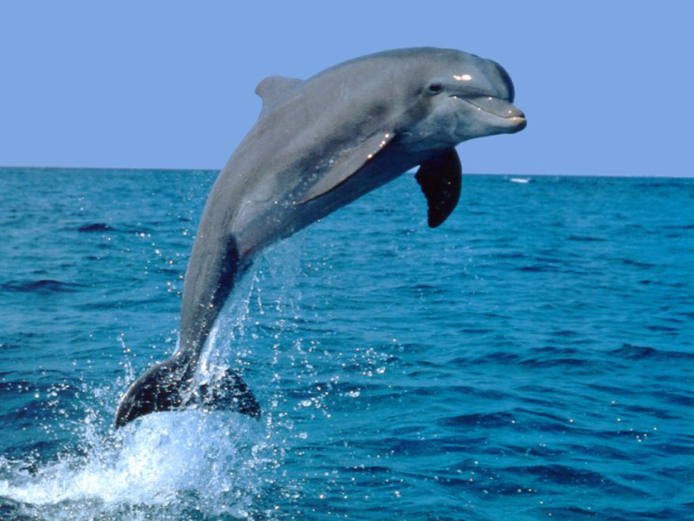
9. What am I?

Slide 12
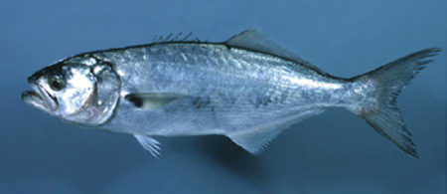
10. What type of fish am I?

Slide 13
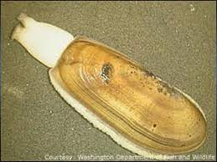
11. What am I?

Slide 14
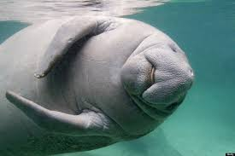
12. What am I called?

Slide 15
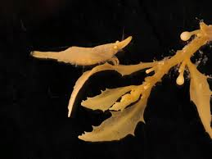
13. This shrimp is hanging out on____

Slide 16
Part II
Now you will simply put a, b, c, or d for the following questions:

Slide 17
14. A tunicate is also known as
A. sand dollar
B. sanamyan
C. squid
D. sea squirt

Slide 18
15. Manatees eat
A. sea shrimp
B. algae
C. crabs
D. clams

Slide 19
16. Leatherback sea turtles eat
A. seaweed
B. crabs
C. jellyfish
D. all of the above

Slide 20
17. Which of the following is the largest sea turtle?
A. Green Sea Turtle
B. Leatherback
C. Hawkbill
D. Loggerhead

Slide 21
18. Sturgeon eat
A. worms
B. mollusks
C. insect larvae
D. all of the above

Slide 22
19. The part that secures seaweed to the ocean floor is called:
A. holdfast
B. frond
C. blade
D. stipe

Slide 23
20. Why are Bottlenose Dolphins born tail first?
A. to get them used to using their tail
B. so the cold water doesn’t cause their bodies to go into shock
C. to keep them from swimming away from their mother
D. so the baby dolphin doesn’t drown

Slide 24
21. Which statement is true for Atlantic Sturgeon?
A. females are larger than males
B. Atlantic Sturgeon have been around for only a couple thousand years
C. They are often found in Georgia’s lakes
D. They grow very quickly

Slide 25
22. Clams eat by:
A. catching their food by snapping their shells shut
B. using the “foot” like a hand to catch their food
C. by using siphons to suck in their food
D. none of the above

Slide 26
23. Green Sea Turtles are different from other sea turtles in which way?
A. They are primarily herbivores
B. They live for only about ten years
C. They migrate the longest distance
D. They are larger than the other sea turtles

Slide 27
24. Starfish eat their prey by:
A. crushing its prey and eating it
B. by extending its stomach out through its mouth
C. grazing on the moss as the starfish moves over it
D. all of the above

Slide 28
25. Sand Dollars are also known as:
A. Dutch discs
B. white sea flowers
C. sea biscuits
D. Spanish dollars

Slide 29
26. Right Whales got their name because:
A. they were the right whale to hunt
B. they always land on their right side when they jump out of the water
C. They always turn right when avoiding ships
D. When swimming in pods, they switch to the right to allow other whales to move to the front

Slide 30
27. What type of flounders may we find off the coast of Georgia?
A. Summer Flounder
B. Winter Flounder
C. Southern Flounder
D. all of the above

Slide 31

You are now done!

