Slide 1
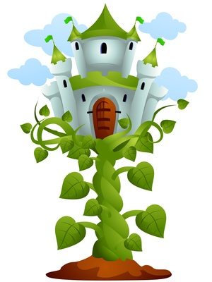
Balance with Jack and the Beanstalk

Slide 2
Read Story
On the iPad…
-Tap Other Education Apps Folder
-Tap Jack
-Tap Read to Me

Slide 3
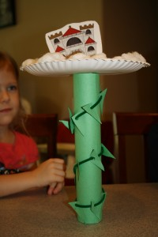
Balancing the Castle on the Beanstalk
Practice balancing the castle on the beanstalk. Let each partner try it two times each.

Slide 4
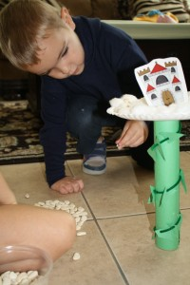
Balancing Beans
Take turns putting beans on top of the beanstalk.
When the beanstalk falls over, place the beans in a cup and set aside.
Repeat 5 times.

Slide 5
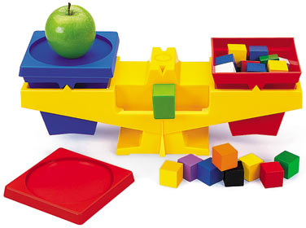
Measuring Beans
Put a cup on each side of the scale.
Leave the heavier cup on the scale but replace the lighter one.
Do this until you have tested all 5 cups.

Slide 6
Counting Beans
Count how many beans are in your heaviest cup.
Why do you think we count this cup?
Place your number on the giant beanstalk.

