Slide 1

Advanced Strategies Lab findley Oaks elementary
Sharon Ferguson M.ED.

Slide 2
I can’t wait to go to Advanced Strategies Lab and play Legos!
Advanced Strategies Lab is NOT
playing with Legos! It’s using Legos to create, build, design, and invent! We also get to play critical thinking games to learn to strategize and problem solve! We’re going to learn some COOL stuff in LAB this year!!

Slide 3

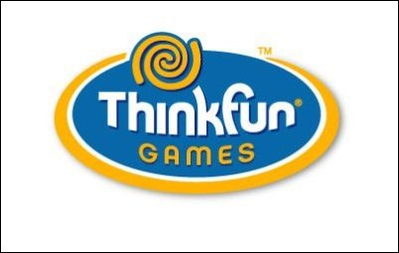
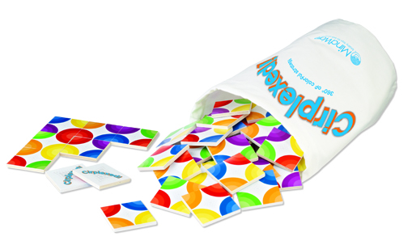
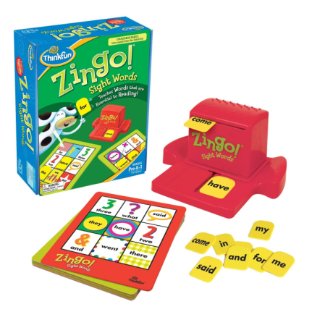
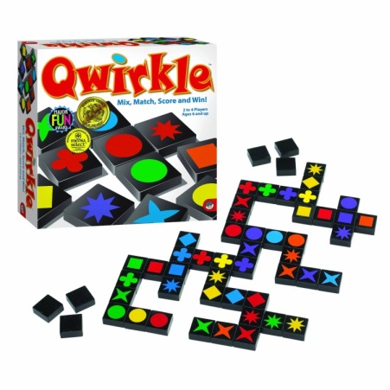
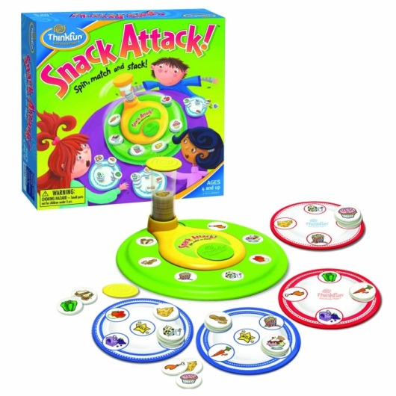
Mindware and Thinkfun are award winning, engaging educational games and learning tools that encourage students to use critical and higher order thinking skills to strategize and problem solve!

Slide 4
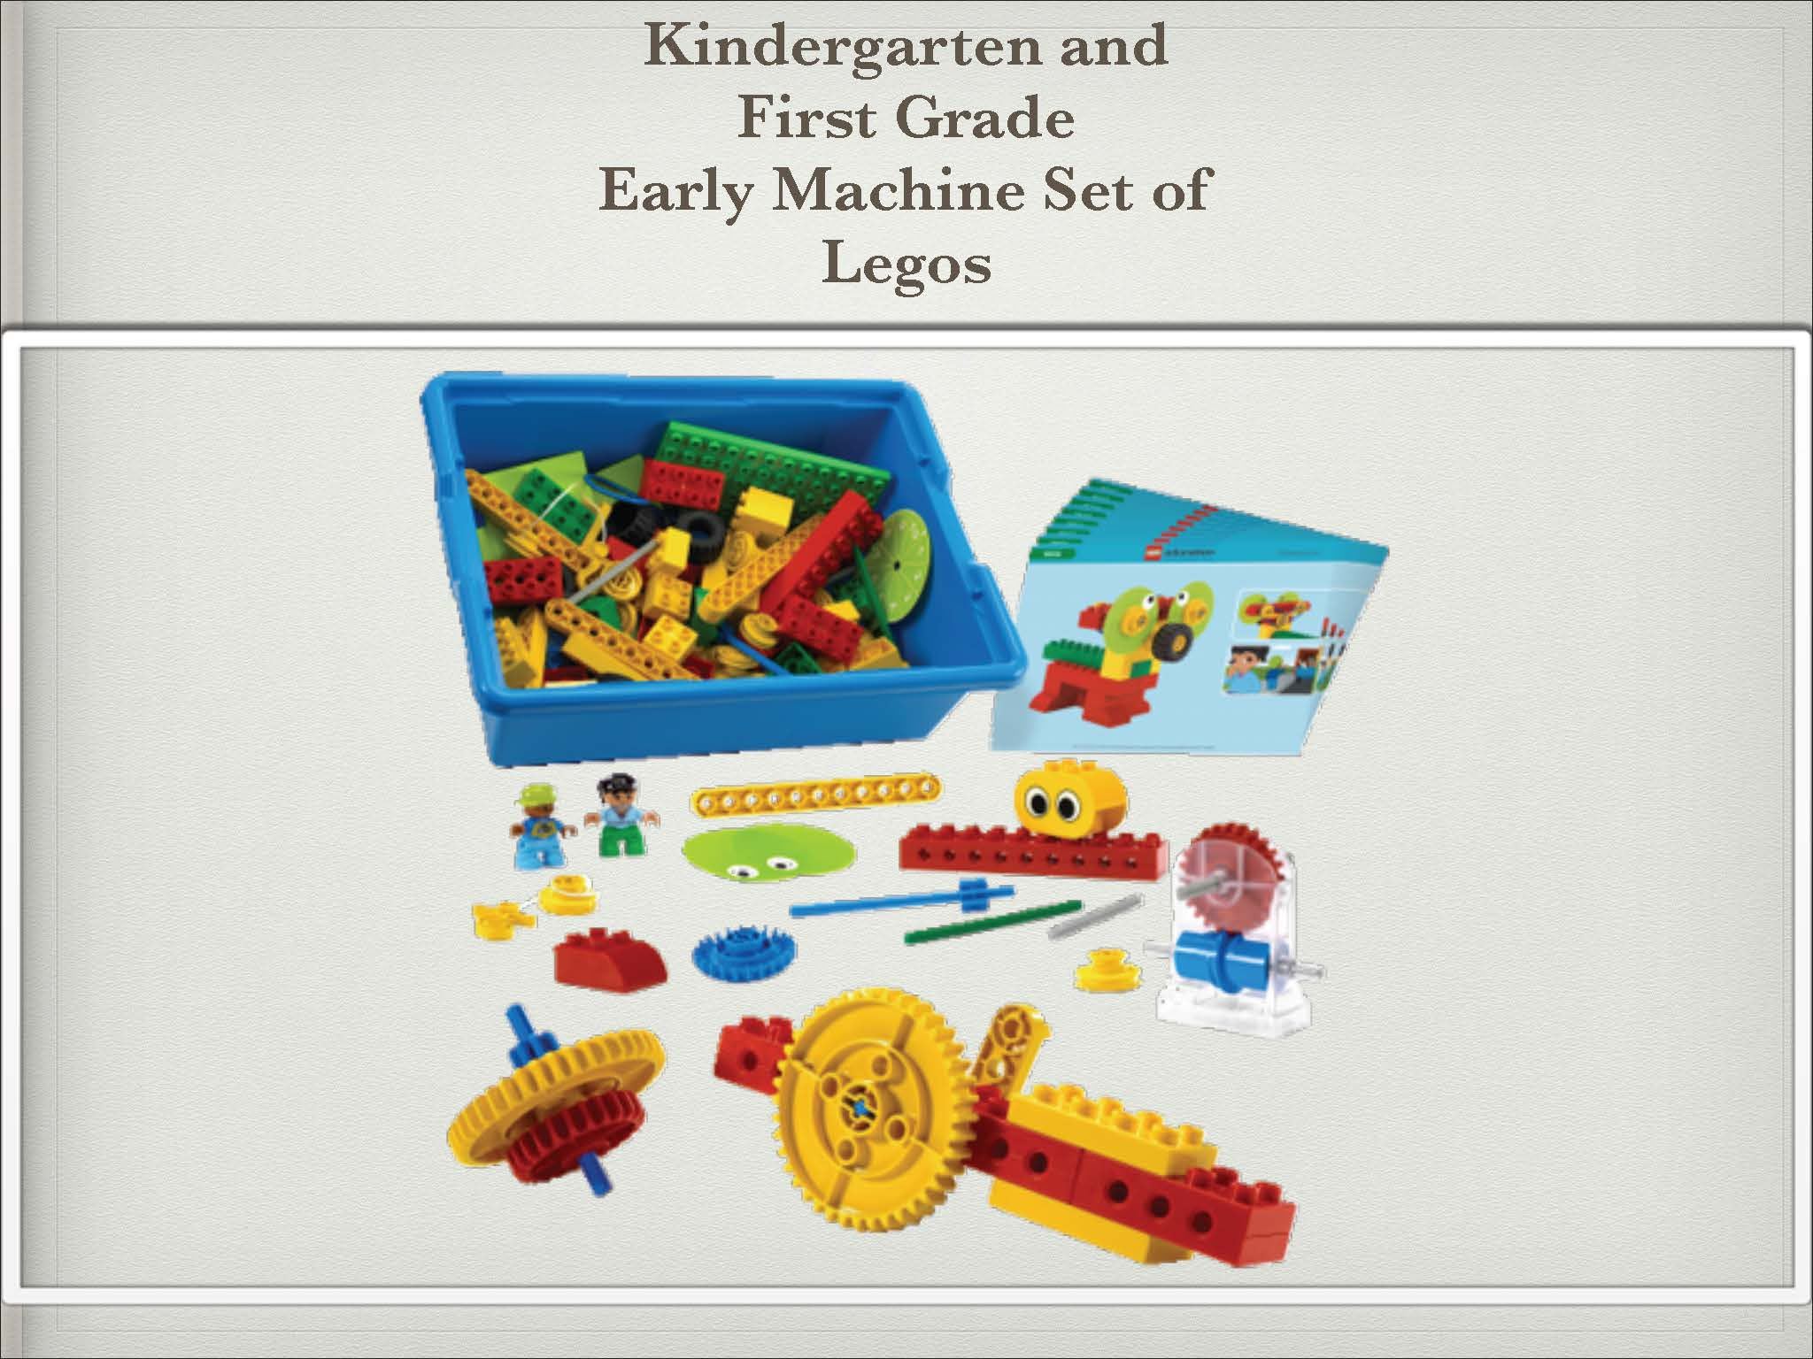
The Early Machines set of Legos is used by Kindergarten and First Grade to solve problems using simple machines. The larger Duplo bricks allow the children to manipulate the bricks to create and build while developing their fine motor skills. With this set, students build, test, and make predictions about how their machines will perform.

Slide 5
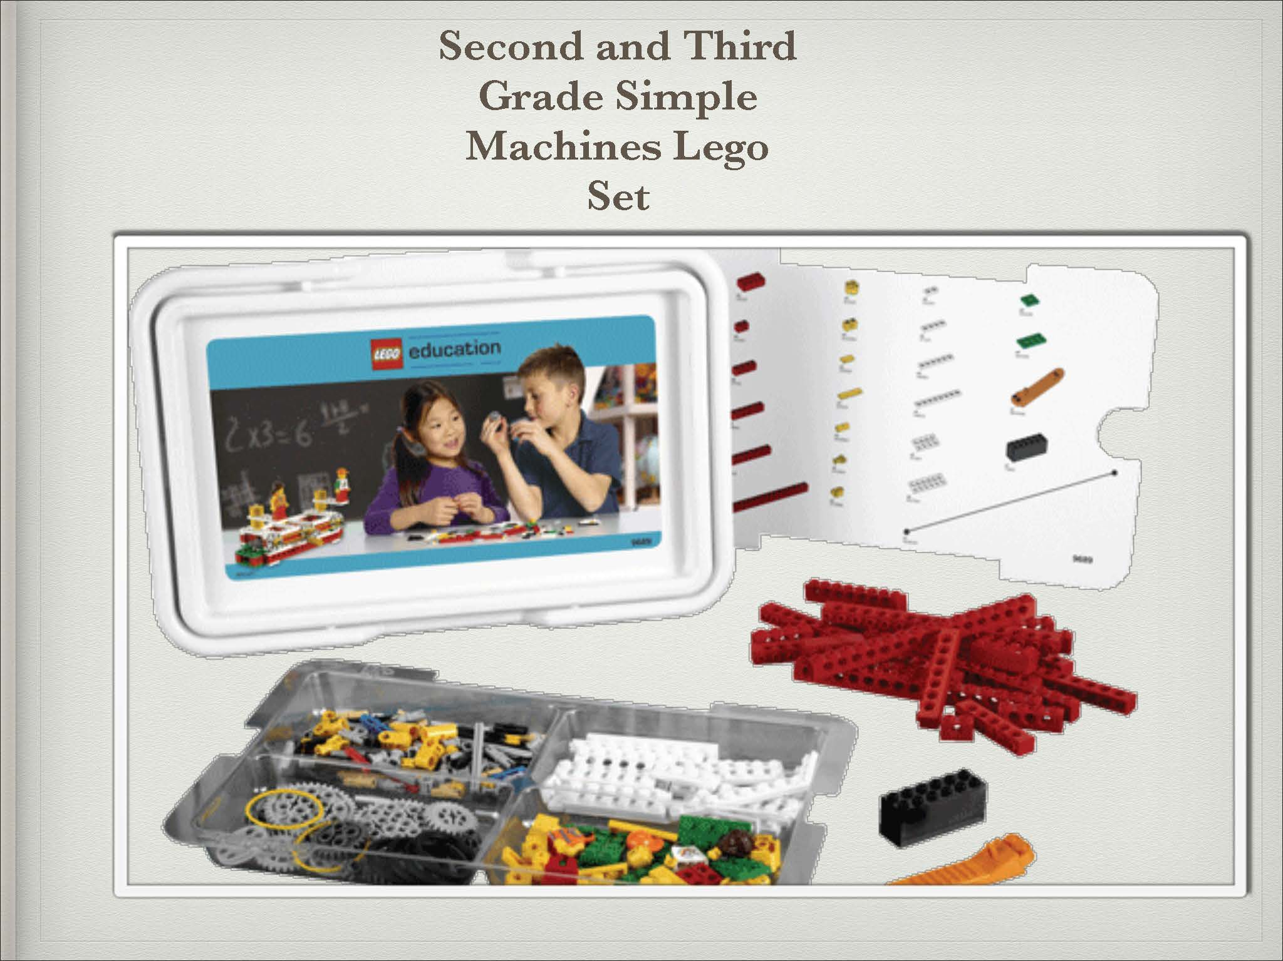
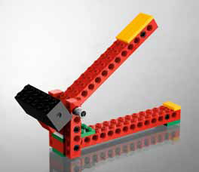
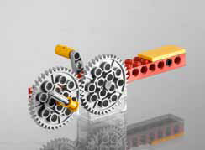
The second and third grade Simple Machines Lego Set is designed to introduce students further to gears, pulleys, levers, wheels and axles. The accompanying Activity Pack enables students to work as young scientists and engineers allowing them to investigate and understand how and why simple machines work. In addition, the continue to develop their problem solving skills and strategies, communication of ideas and teamwork. The activities lead students to make initial use of scientific method through observation, reasoning, prediction and critical thinking.

Slide 6
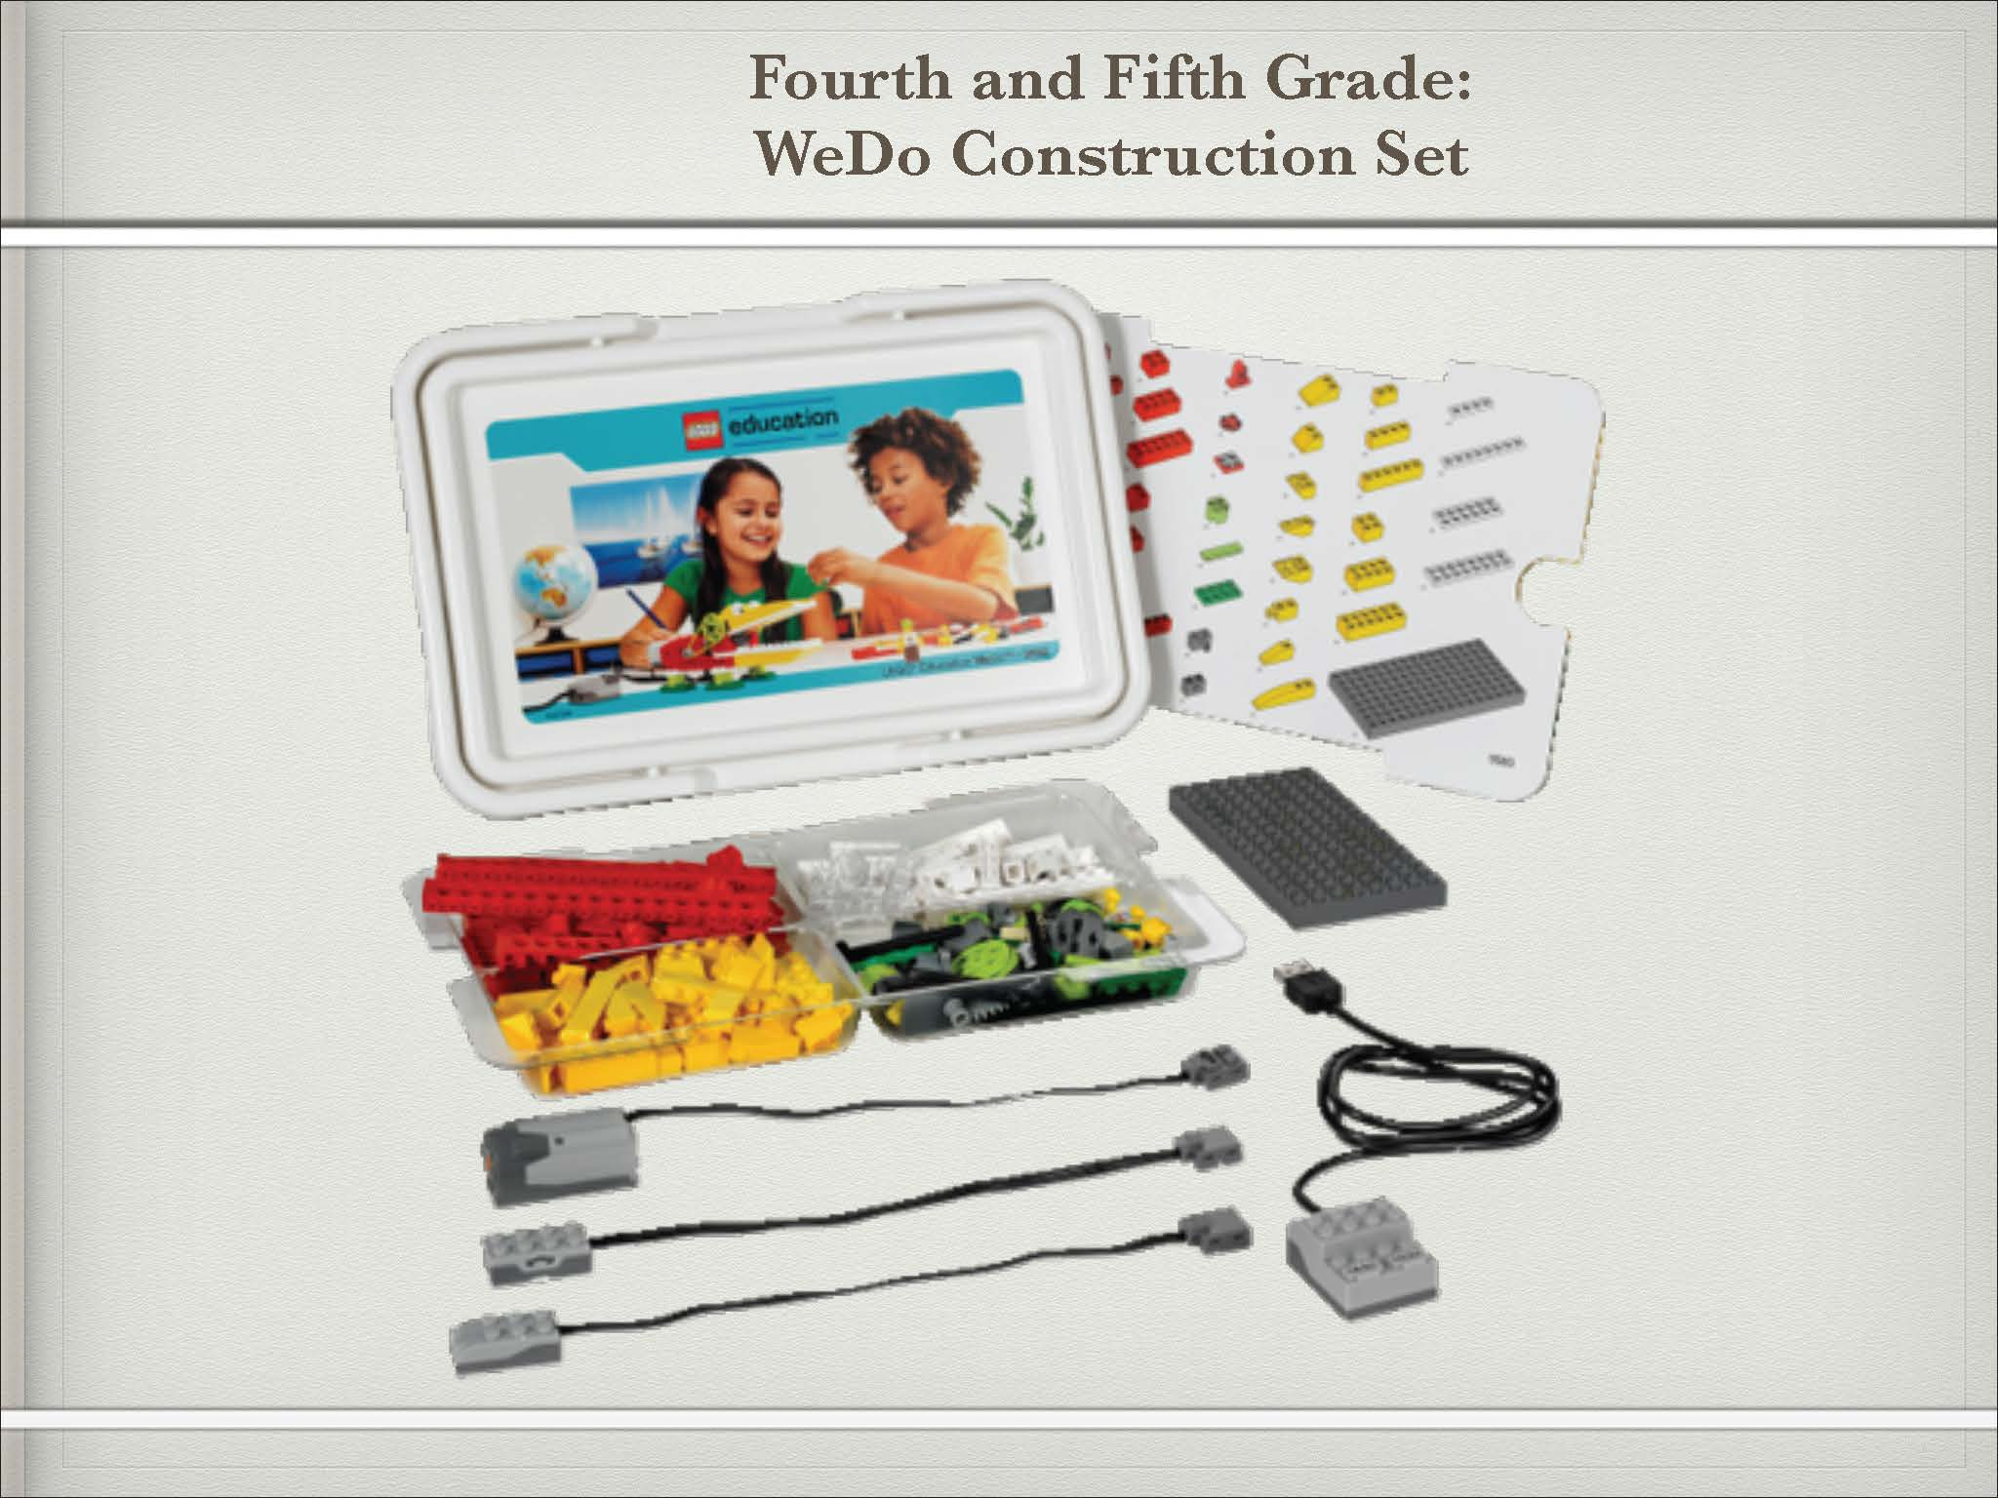
The materials in the WeDo Construction Set is used in pairs in grades 4-5. The pack enables students to work as young scientists, engineers, mathematicians and creative writers providing them with the settings, tools and tasks for completing cross-curricular projects. Using these materials, students are encouraged to build and program a working model and then use the model for different purposes, depending on the theme of the activity and its focused subject matter in science, technology, mathematics or language.
The WeDo Activity Pack enables us to provide learning opportunities for developing these broader learning goals.
Think creatively to make a working model
Develop vocabulary and communication skills to explain how the model works
Establish links between cause and effect
Reflect on how to find answers and imagine new possibilities
Brainstorm ideas and seek to bring them to fruition
Test by changing one factor and observing/measuring effect

Slide 7
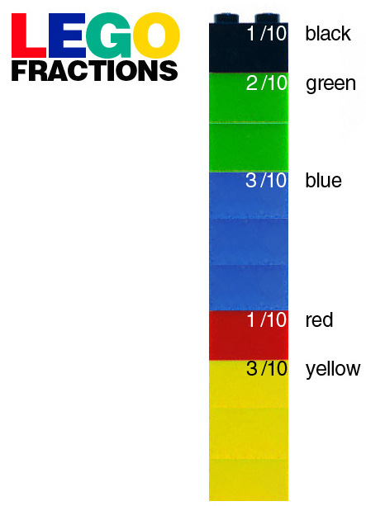
Students will be learning how to use Lego bricks to not only to create and build but to also assist them in understanding fractions, decimals, and percentages!

